Slide 1
Advanced Data Analysis GLM 367-2-5461
Opher Donchin

Slide 2
Topics
BMCP
Logistic regression in 1 or 2 variables
Interpreting parameters of logistic regression
Putting common sense into priors
Unbalanced data in logistic regression
BAP
Softmax regression
Poisson regression
Zero-inflated Poisson regression
Robust logistic regresion

Slide 3
Generalized linear model
Simple linear regression
Logistic regression

Slide 4
Types of links
A “link” function transforms the response variable to a form where it can be expressed as a linear combination of predictors
We often think in terms of the “inverse link” function

Slide 5
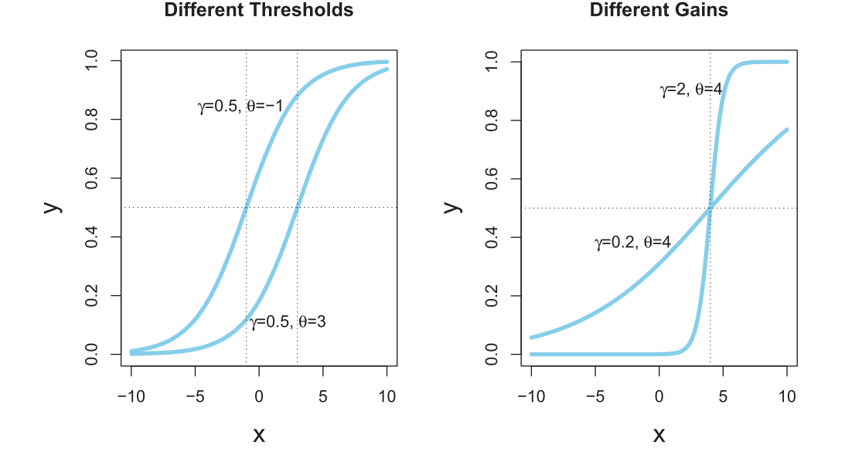
Logistic link function

Slide 6
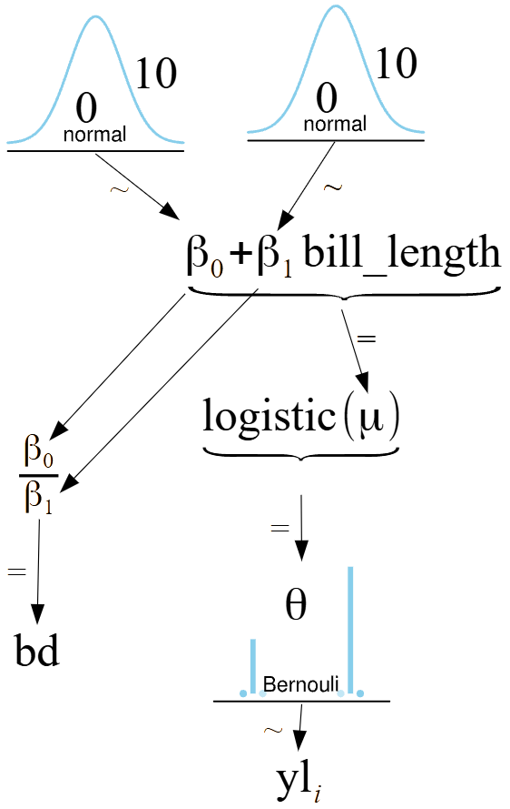
The logistic regression model
with pm.Model() as model_logistic_penguins_bill_length:
β_0 = pm.Normal("β_0", mu=0, sigma=10)
β_1 = pm.Normal("β_1", mu=0, sigma=10)
μ = β_0 + pm.math.dot(bill_length_obs, β_1)
# Application of our sigmoid link function
θ = pm.Deterministic("θ", pm.math.sigmoid(μ))
# Useful for plotting the decision boundary later
bd = pm.Deterministic("bd", -β_0/β_1)
# Note the change in likelihood
yl = pm.Bernoulli("yl", p=θ, observed=species.codes)

Slide 7
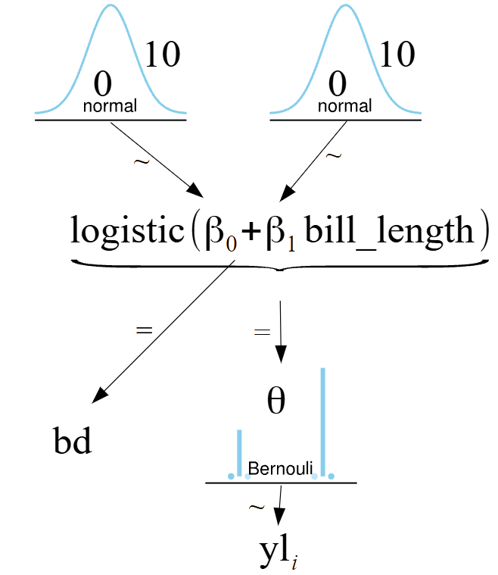
The logistic regression model
with pm.Model() as model_logistic_penguins_bill_length:
β_0 = pm.Normal("β_0", mu=0, sigma=10)
β_1 = pm.Normal("β_1", mu=0, sigma=10)
μ = β_0 + pm.math.dot(bill_length_obs, β_1)
# Application of our sigmoid link function
θ = pm.Deterministic("θ", pm.math.sigmoid(μ))
# Useful for plotting the decision boundary later
bd = pm.Deterministic("bd", -β_0/β_1)
# Note the change in likelihood
yl = pm.Bernoulli("yl", p=θ, observed=species.codes)

Slide 8
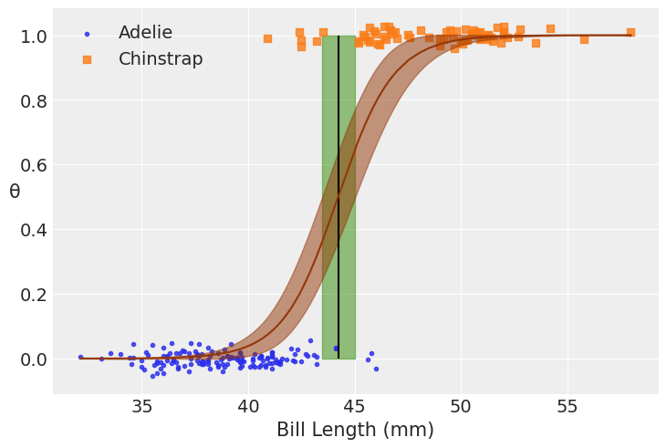
The logistic regression fit

Slide 9
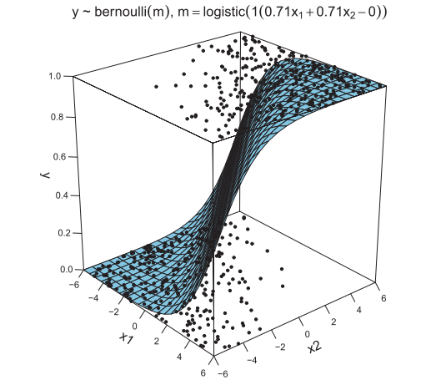
Logistic regression
Link is logistic
PDF is Bernoulli
No additional parameters

Slide 10
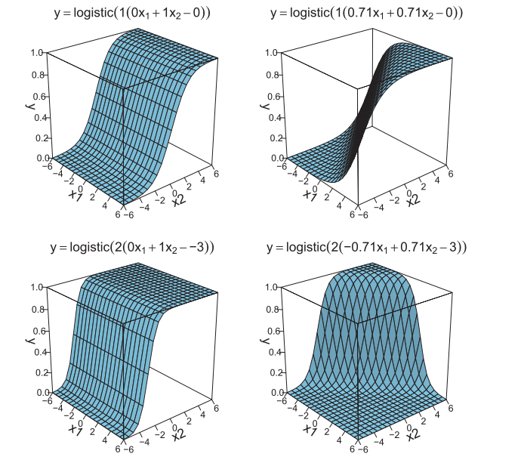
Multivariate logistic prediction

Slide 11
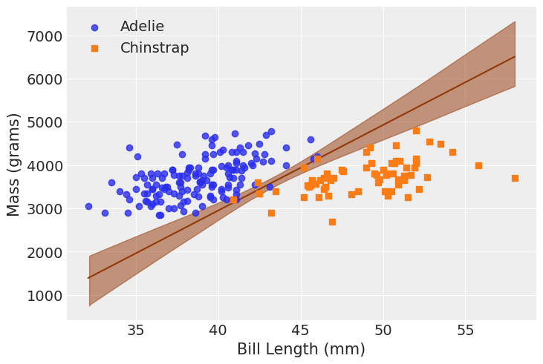
Boundary for multiple logistic regression
Axes are independent variables
Line is decision boundary

Slide 12
How to make the graph
Step through the code
fig,ax = plt.subplots()
idx = np.argsort(X[:,1])
bd = inf_data_logistic_penguins_bill_length_mass.posterior["bd"].values.reshape((-1,214)).mean(axis=0)[idx]
species_filter = species.codes.astype(bool)
# Linear fit
ax.plot(X[:,1][idx], bd, color='C4');
az.plot_hdi(X[:,1], inf_data_logistic_penguins_bill_length_mass.posterior["bd"].values.reshape((-1,214)), color='C4', ax=ax)
# Scatter
ax.scatter(X[~species_filter,1], X[~species_filter,2], alpha=.8, label="Adelie", zorder=10)
ax.scatter(X[species_filter,1], X[species_filter,2], marker="s", label="Chinstrap", zorder=10)

Slide 13
Topics
BMCP
Logistic regression in 1 or 2 variables
Interpreting parameters of logistic regression
Putting common sense into priors
Unbalanced data in logistic regression
BAP
Softmax regression
Poisson regression
Zero-inflated Poisson regression
Robust logistic regresion

Slide 14
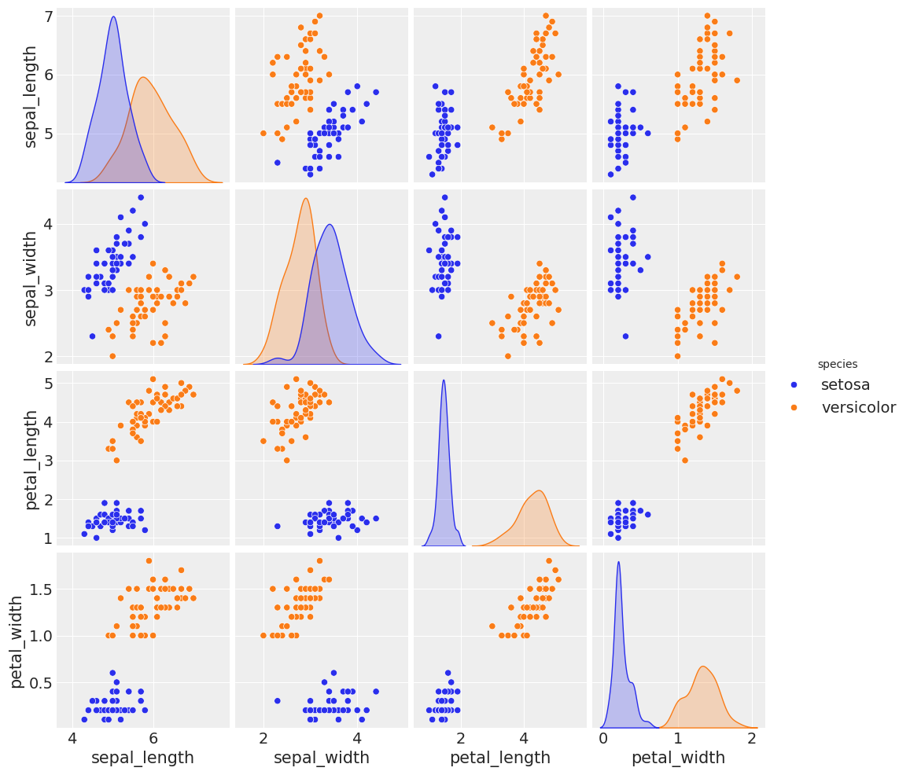
Correlated variables in logistic regression
Text uses sepal width and length
Exercise: use leaf width and length instead

Slide 15
Small change in the code
The question: generic or specific code in models?
df = iris.query("species == ('setosa', 'versicolor')")
y_1 = pd.Categorical(df['species']).codes
x_n = ['sepal_length', 'sepal_width']
x_1 = df[x_n].values
df = iris.query("species == ('setosa', 'versicolor')")
y_1 = pd.Categorical(df['species']).codes
x_n = ['petal_length', 'petal_width']
x_1 = df[x_n].values
with pm.Model() as model_1:
α = pm.Normal('α', mu=0, sigma=10)
β = pm.Normal('β', mu=0, sigma=2, shape=len(x_n))
μ = α + pm.math.dot(x_1, β)
θ = pm.Deterministic('θ', 1 / (1 + pm.math.exp(-μ)))
bd = pm.Deterministic('bd', -α/β[1] - β[0]/β[1] * x_1[:,0])
yl = pm.Bernoulli('yl', p=θ, observed=y_1)
idata_1 = pm.sample(2000, target_accept=0.95, return_inferencedata=True)

Slide 16
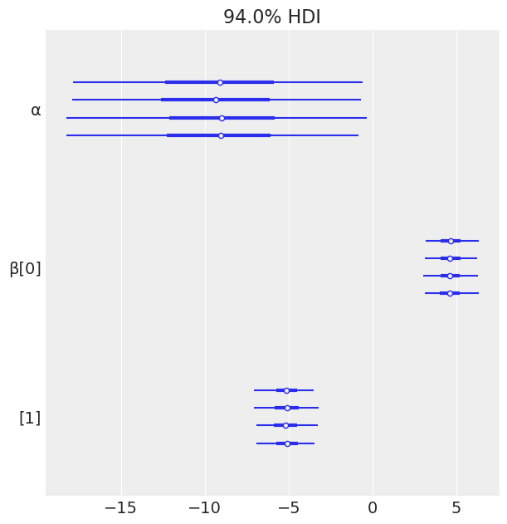
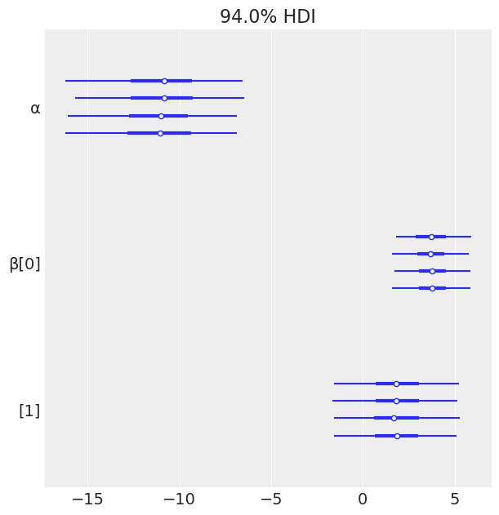
Big change in parameter variance

Slide 17
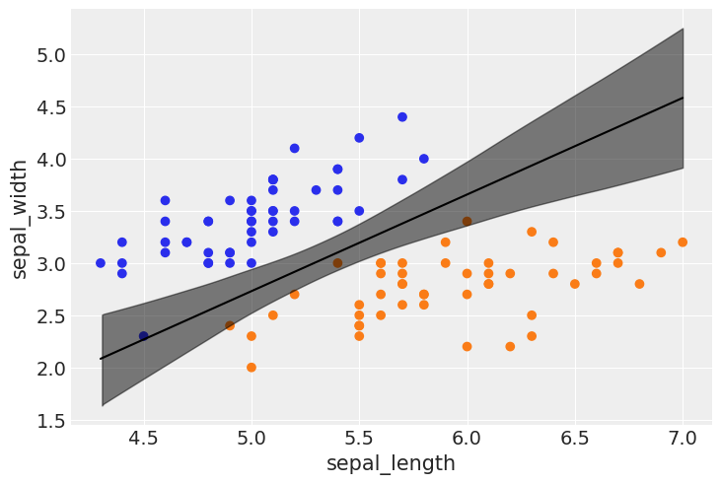
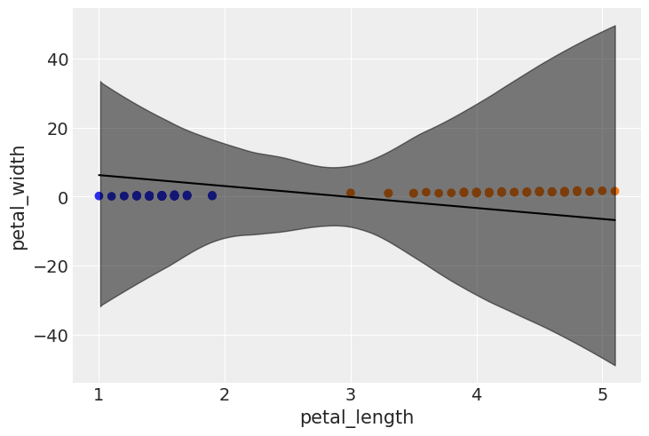
Big change in parameter variance

Slide 18
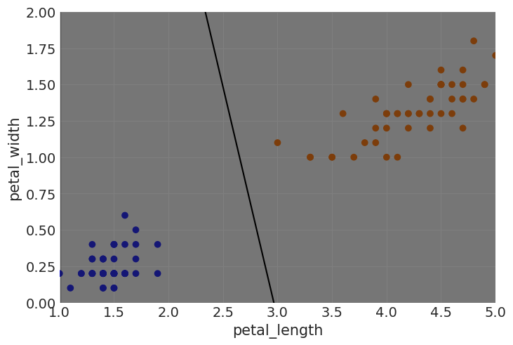
Big change in parameter variance

Slide 19
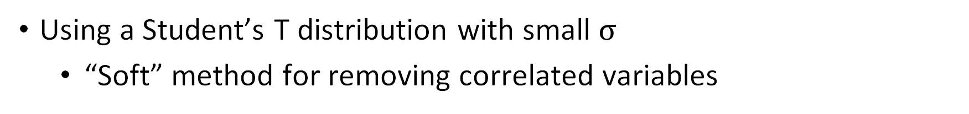
Reduce multicollinearity
Using a Student’s T distribution with small $σ$
“Soft” method for removing correlated variables
with pm.Model() as model_1a:
α = pm.Normal('α', mu=0, sigma=10)
β = pm.StudentT('β', mu=0, sigma=0.5, nu=7, shape=len(x_n))
μ = α + pm.math.dot(x_1, β)
θ = pm.Deterministic('θ', 1 / (1 + pm.math.exp(-μ)))
bd = pm.Deterministic('bd', -α/β[1] - β[0]/β[1] * x_1[:,0])
yl = pm.Bernoulli('yl', p=θ, observed=y_1)
idata_1a = pm.sample(2000, target_accept=0.95, return_inferencedata=True)

Slide 20
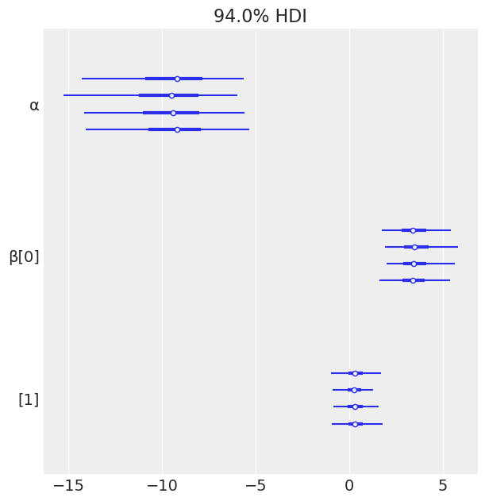
This biases the estimates and reduces the variances
Normal prior
Student’s t prior

Slide 21
Topics
BMCP
Logistic regression in 1 or 2 variables
Interpreting parameters of logistic regression
Putting common sense into priors
Unbalanced data in logistic regression
BAP
Softmax regression
Poisson regression
Zero-inflated Poisson regression
Robust logistic regresion

Slide 22
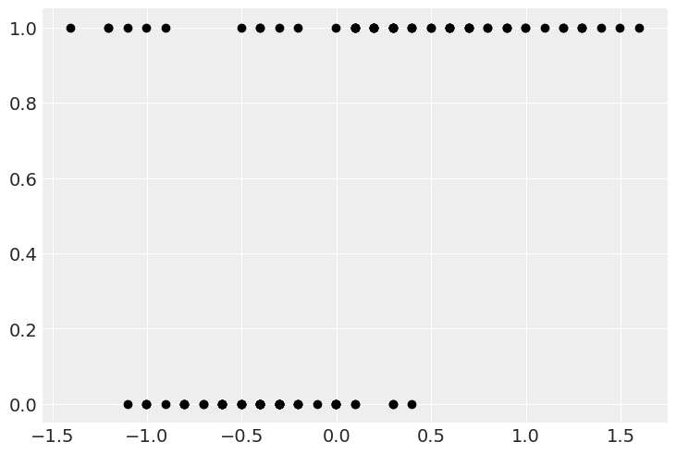
Robust logistic regression
Assume some data is just completely random

Slide 23
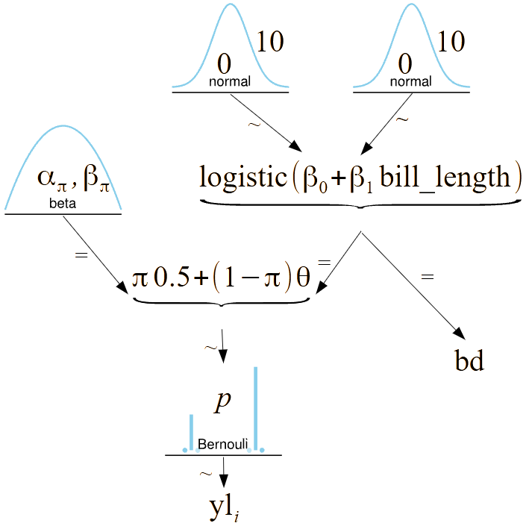
Robust logistic regression
Assume some data is just completely random
with pm.Model() as model_rlg:
α = pm.Normal('α', mu=0, sigma=10)
β = pm.Normal('β', mu=0, sigma=10)
μ = α + x_c * β
θ = pm.Deterministic('θ', pm.math.sigmoid(μ))
bd = pm.Deterministic('bd', -α/β)
π = pm.Beta('π', 1., 1.)
p = π * 0.5 + (1 - π) * θ
yl = pm.Bernoulli('yl', p=p, observed=y_0)

Slide 24
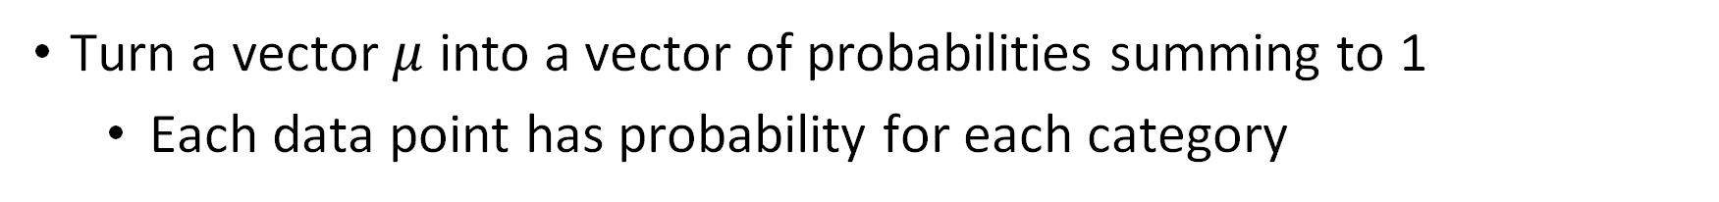
Softmax
Turn a vector $μ$ into a vector of probabilities summing to 1
Each data point has probability for each category
Logistic regression
Softmax regression

Slide 25
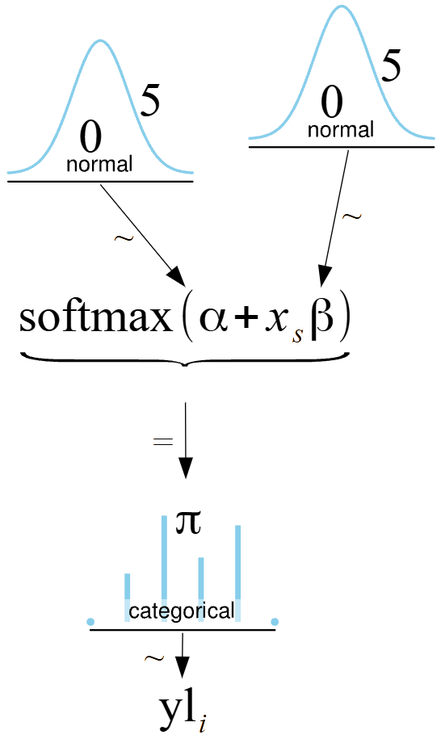
Model for softmax
species = pd.Categorical(iris['species']).categories
features = list(iris.columns[:-1])
data = np.arange(len(y_s))
coords = {'species': species, 'features': features, 'data': data}
with pm.Model(coords=coords) as model_s:
α = pm.Normal('α', mu=0, sigma=5, dims='species')
β = pm.Normal('β', mu=0, sigma=5, dims=['features', 'species'])
μ = pm.Deterministic('μ', α + pm.math.dot(x_s, β), dims=['data','species'])
θ = pm.math.softmax(μ, axis=1)
yl = pm.Categorical('yl', p=θ, observed=y_s, dims='data')

Slide 26
Compare shape and dims
with pm.Model() as model_s:
α = pm.Normal('α', mu=0, sigma=5, shape=3)
β = pm.Normal('β', mu=0, sigma=5, shape=(4,3))
μ = pm.Deterministic('μ', α + pm.math.dot(x_s, β))
θ = pm.math.softmax(μ, axis=1)
yl = pm.Categorical('yl', p=θ, observed=y_s)
species = pd.Categorical(iris['species']).categories
features = list(iris.columns[:-1])
data = np.arange(len(y_s))
coords = {'species': species, 'features': features, 'data': data}
with pm.Model(coords=coords) as model_s:
α = pm.Normal('α', mu=0, sigma=5, dims='species')
β = pm.Normal('β', mu=0, sigma=5, dims=['features', 'species'])
μ = pm.Deterministic('μ', α + pm.math.dot(x_s, β), dims=['data','species'])
θ = pm.math.softmax(μ, axis=1)
yl = pm.Categorical('yl', p=θ, observed=y_s, dims='data')

Slide 27

Reduce extra degree of freedom
We can fix 1 $β$ for each feature
Without loss of generality
with pm.Model(coords=coords) as model_sf:
α = pm.Normal('α', mu=0, sigma=2, shape=len(species)-1)
β = pm.Normal('β', mu=0, sigma=2, shape=(len(features), len(species)-1))
α_f = pt.concatenate([[0] ,α])
β_f = pt.concatenate([np.zeros((len(features),1)) , β], axis=1)
μ = pm.Deterministic('μ', α_f + pm.math.dot(x_s, β_f), dims=['data','species'])
θ = pm.math.softmax(μ, axis=1)
yl = pm.Categorical('yl', p=θ, observed=y_s, dims='data')

Slide 28
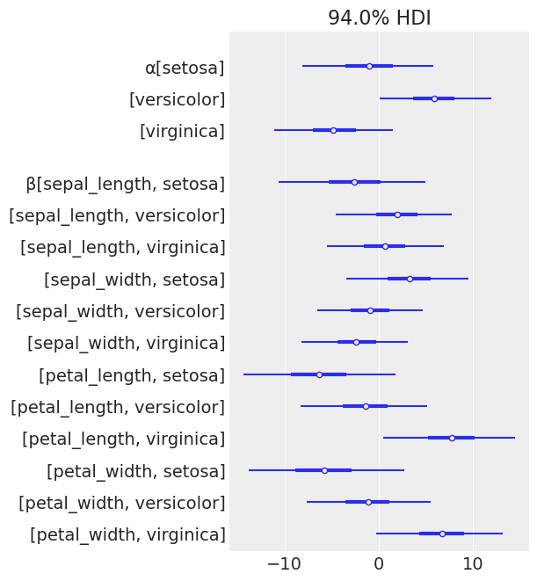
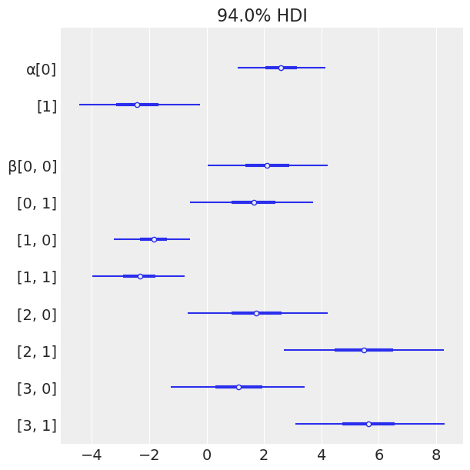
Eliminating the extra variable reduces variance
Reduced model
Full model

Slide 29
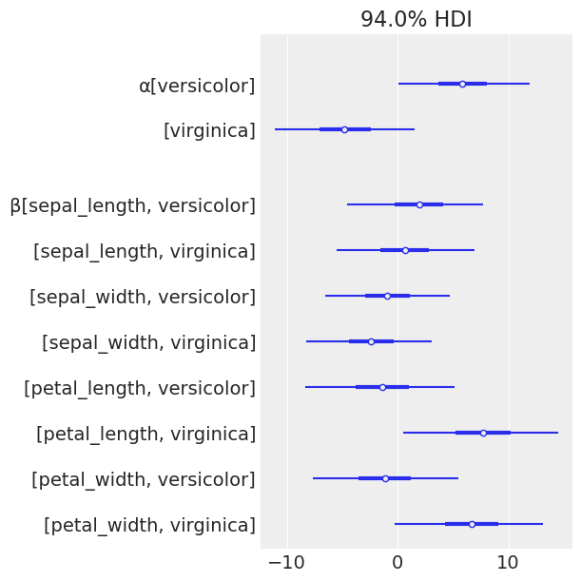
Eliminating the extra variable reduces variance
Full model
Reduced model

Slide 30
Topics
BMCP
Logistic regression in 1 or 2 variables
Interpreting parameters of logistic regression
Putting common sense into priors
Unbalanced data in logistic regression
BAP
Softmax regression
Poisson regression
Zero-inflated Poisson regression
Robust logistic regresion

Slide 31
Poisson regression
Count data
Logistic regression
Poisson regression

Slide 32
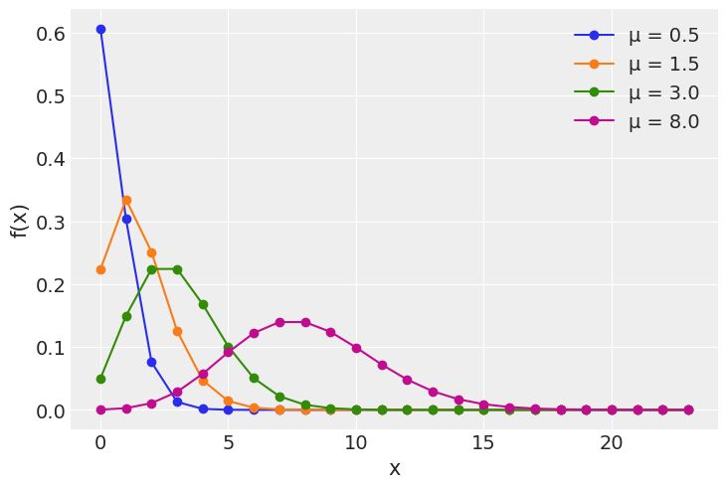
The Poisson distribution
The variance is equal to the mean
Which can be a problem

Slide 33
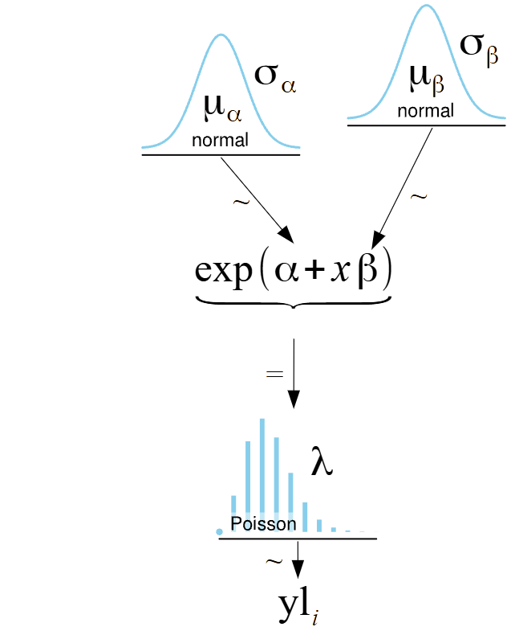
Poisson regression
These models can be problematic because the likelihood is too constrained
Data is ofen over- or under-dispersed

Slide 34
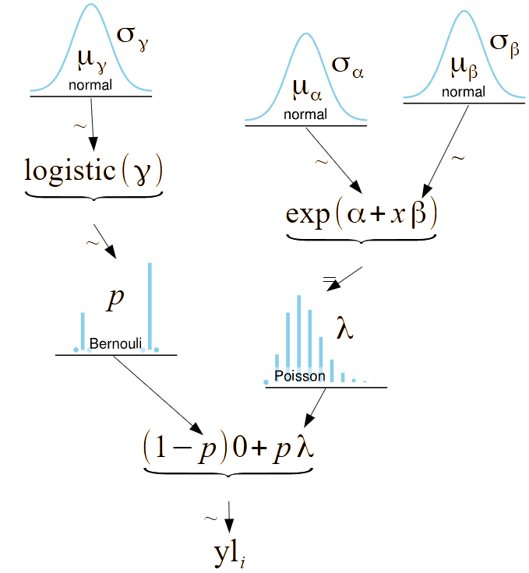
Zero-Inflated Poisson regression
One common deviation from Poisson is extra 0s
Because of no-counts mixed in

Slide 35
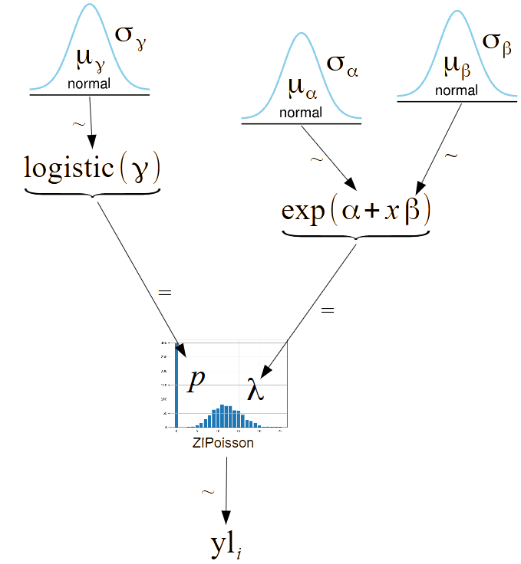
Zero-Inflated Poisson distribution
One of many “composite” distribution in PyMC
with pm.Model() as ZIP_reg:
ψ = pm.Beta('ψ', 1, 1)
α = pm.Normal('α', 0, 10)
β = pm.Normal('β', 0, 10, shape=2)
θ = pm.math.exp(α + β[0] * fish_data['child'] + β[1] * fish_data['camper'])
yl = pm.ZeroInflatedPoisson('yl', ψ, θ, observed=fish_data['count'])

Slide 36
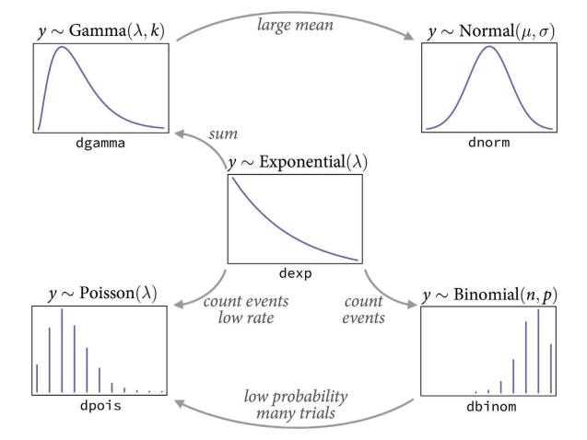
The GLM distributions

Slide 37
Stuff to discuss 2
Debugging colab
Model-to-graphviz
Check dimensions
Explanatory notebooks:
Debugging
Understanding PyTensor
Understanding dimensions

Slide 38
Reading for next week
BMCP Chapter 3.5
Leave one out and cross validation
Expected log predictive density (EPLD)
Pareto sampling for extreme points
Model averaging
BMCP 11.4 and 11.5
Information criteria in depth
LOO in depth
SR 7
A very different presentation. Worth checking out.
BAP Chapter 5
Posterior predictive
Over and underfitting
Predictive accuracy measures
In and out of sample accuracy
Cross validation and information criteria
Bayes factors
The and the bad
Computing
WAIC in depth

